Slide 1
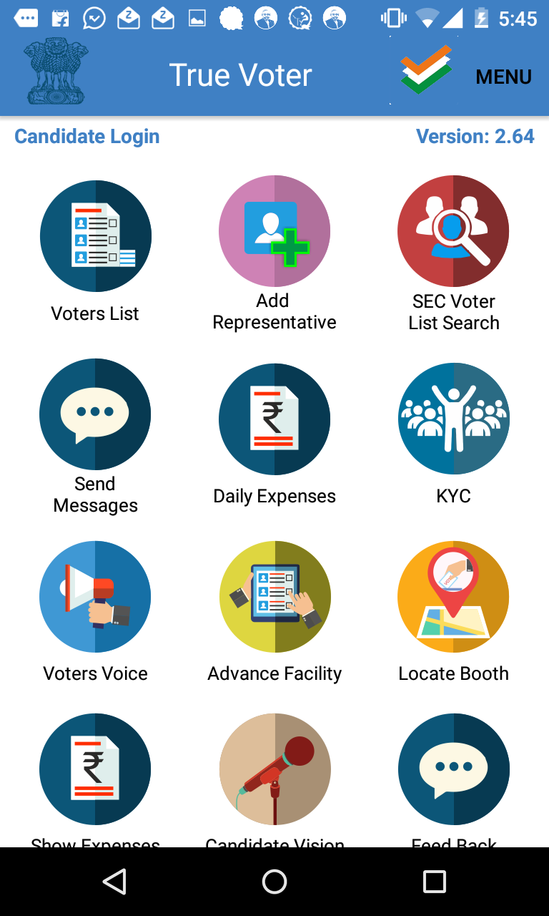
True Voter version 2.64
Daily Expenses Module :
This function is used to submit daily expenses in the election to the government.
To use daily expense function user should be logged in as a Candidate Role with his Registered Mobile no.
Representative can also use this function.
For this president or ward member have to add representative under his number.
Click on ‘Daily Expenses’ function.

Slide 2
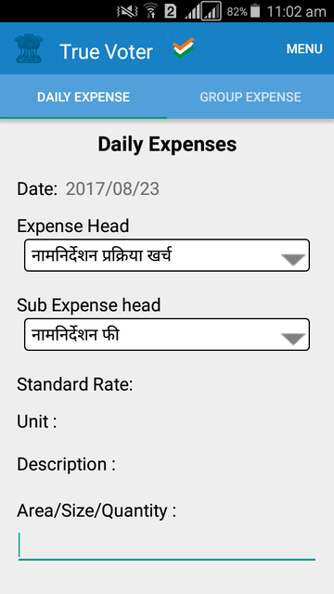
True Voter version 2.64
Daily expense page will be displayed to the user.
Click ‘Menu’ on top right corner of Page to download Standard rate, Expense and sub expense head.

Slide 3
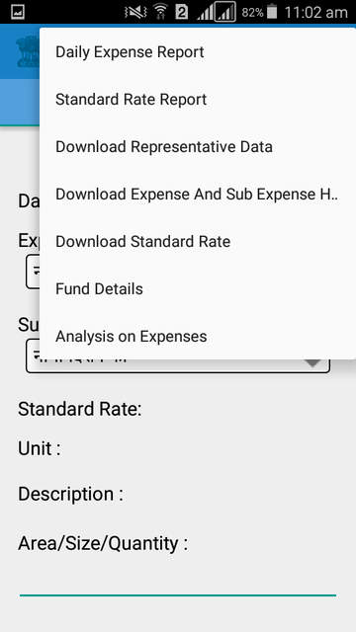
True Voter version 2.64
Click on ‘Download Expense and Sub Expense’ to download Expense head and sub expense heads entered by collector officer. Or by Municipal Commissioner office for corporation.
Please wait for minute to get download Expense and sub expense heads.
Then Click on ‘Download Standard Rate’ option from the given options.
Standard rates entered by ‘Collector officer or collector staff’ will get downloaded here. In case of corporation, rate entered by Municipal Commissioner Staff will get downloaded
Please wait for minute to get download Standard rates.
To see the downloaded Standard rates and Expense and sub expense heads Click on menu “Standard Rate Report”.

Slide 4
True Voter version 2.64
Candidate will get massage that ‘Successfully Downloaded”, when Expense heads and sub expense heads are getting download successfully.
User will get massage that ‘Successfully Downloaded”, when standard rates are getting download successfully.

Slide 5
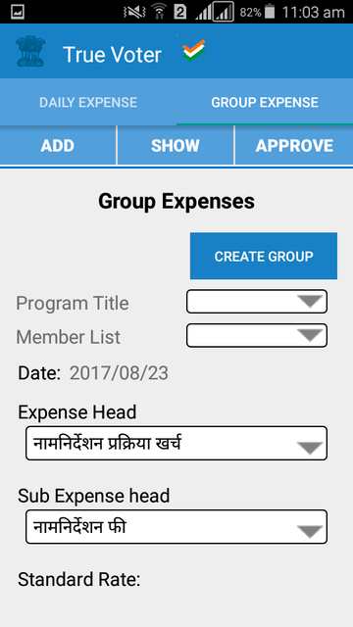
True Voter version 2.64
Click on ‘Group Expense Tab’.
Candidate display this page.
To create group click on ‘Create Group’ button.

Slide 6
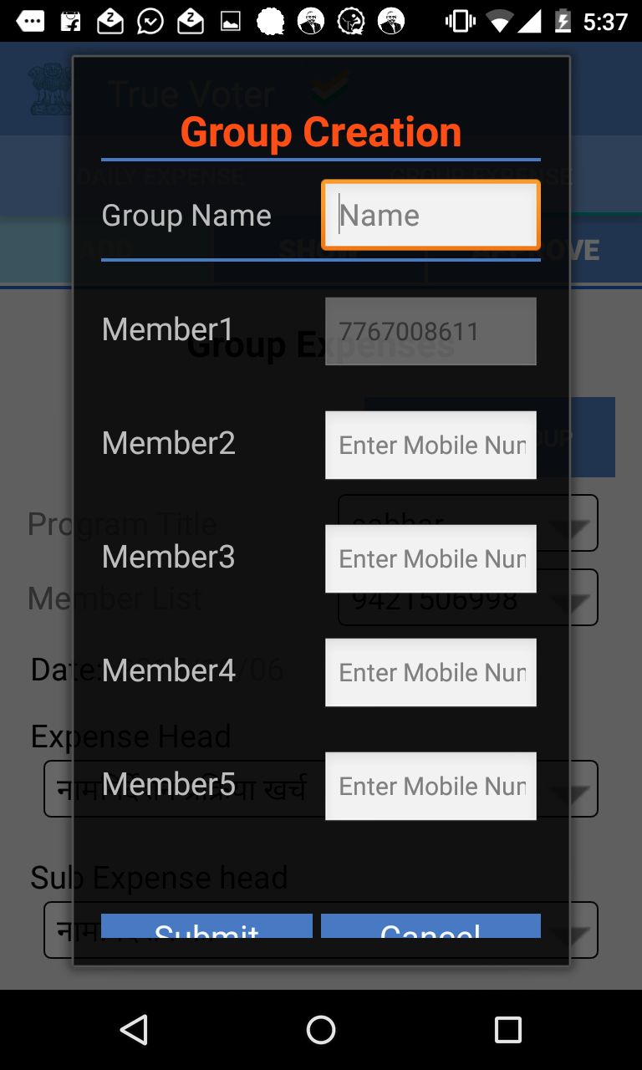
True Voter version 2.64
After Clicking on create group, Create Group screen will open.
Enter your group name.
You are the first member of group.
Add other member numbers in your group by Entering their Mobile No.

Slide 7
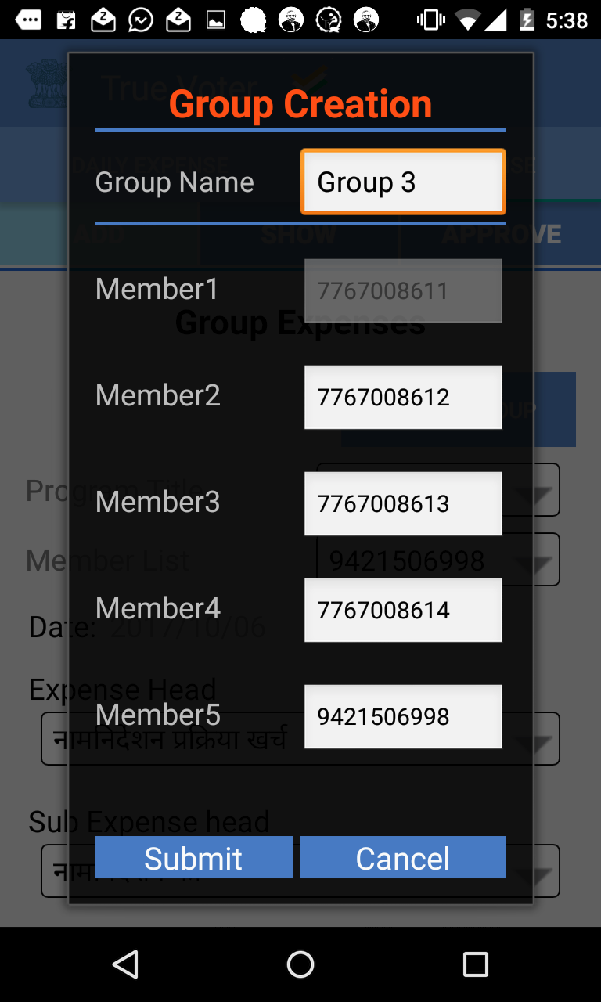
True Voter version 2.64
User can add maximum 5 members Enter mobile numbers of your group Members.
Example is shown in screen.
Click on submit button.
Then your group created successfully.

Slide 8
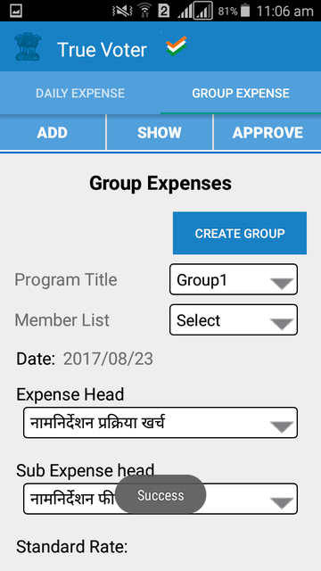
True Voter version 2.64
After click on submit button this screen will open.
Your Group Name will be added in Programm title List
To enter\ Fill Daily expenses of group select your group name From ‘Program Title’.

Slide 9
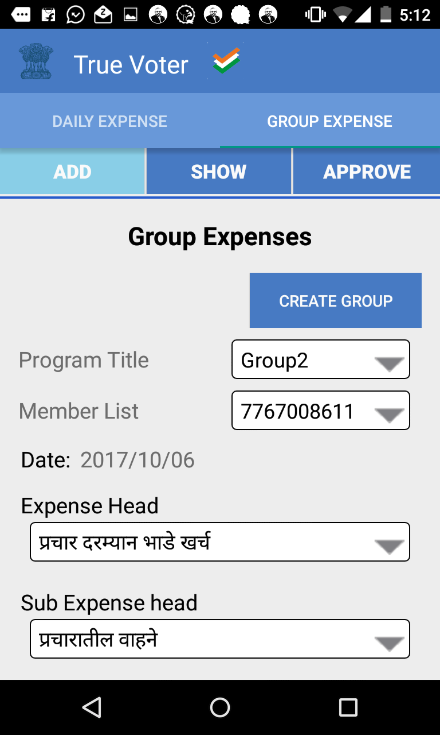
True Voter version 2.64
Group expenses are supposed to be added every day date wise.
Select your date.
Select your ‘Expense head’ and ‘Sub Expense Head’
Example is shown in screen.

Slide 10
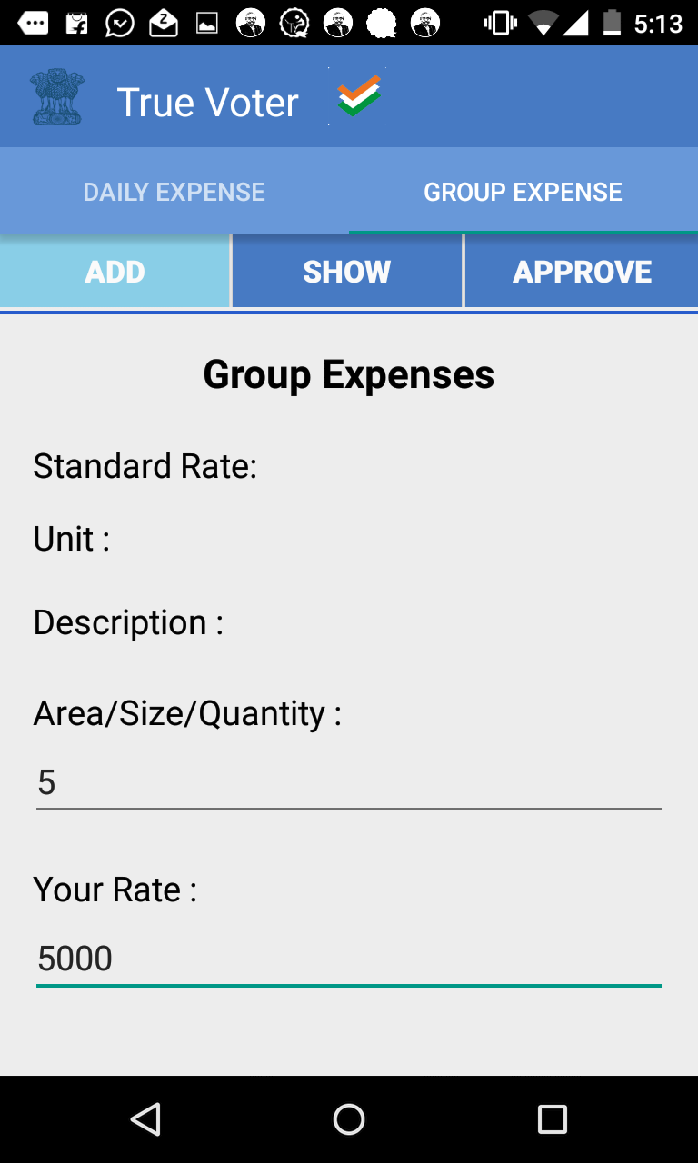
True Voter version 2.64
Enter your Area/Size/Quality.
Enter your rate.
Click on the total field it automatically gives you total.
Example is shown in screen.

Slide 11
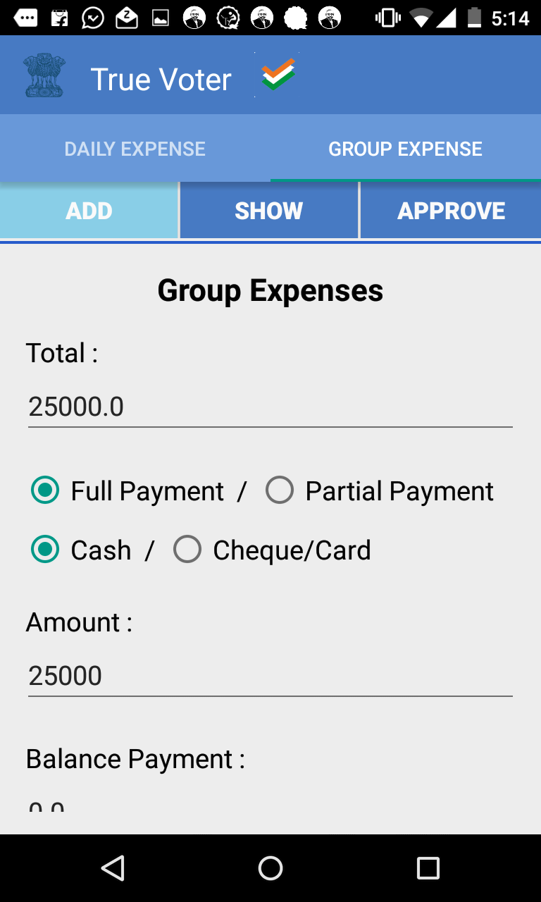
True Voter version 2.64
Select your payment type
Full payment/Partial payment/ Cash/ Cheque/ Card.
Enter your total amount which you have given.
It will automatically shows balance payment.
Enter vendor/ Service provider name.

Slide 12
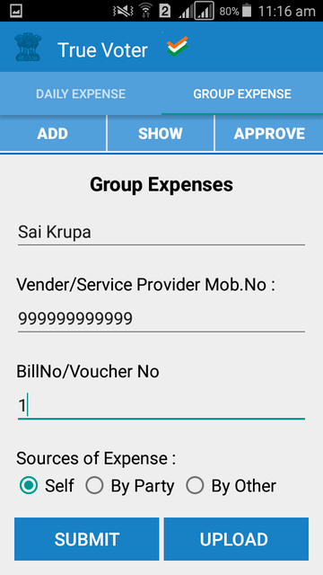
True Voter version 2.64
Enter vener/service provider mob. no. If not available then enter 9999999999.
Provide the Bill no of the entry. If you can’t get Bill no then provide your self created voucher no for payment.
If you had paid your self then use “Self” option or if this is done by party for you then use “By Party” option. If the expenses are done by any friend or relative for you then “By Other” is to be used. Provide that friend name and mobile no.
Click on “Submit” button to save the entry.

Slide 13
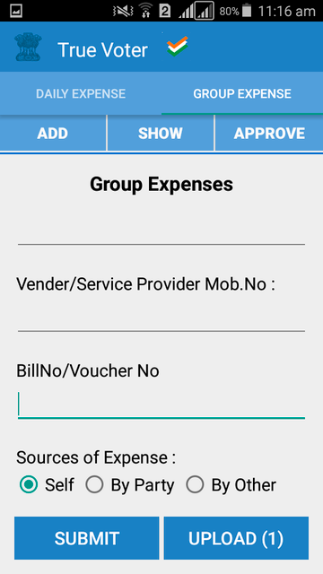
True Voter version 2.64
After click on Submit button you will get count in Upload button.
Click on Upload Button to upload your group Expense.

Slide 14
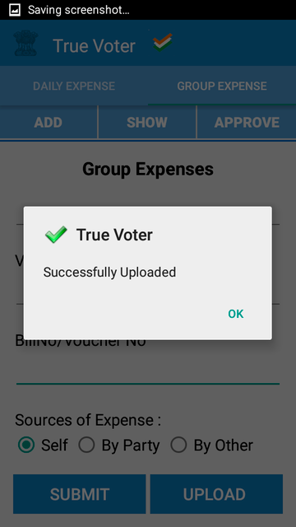
True Voter version 2.64
After uploading your Group Expense
It gives message ‘Successfully Uploaded’
press OK to continue.

Slide 15
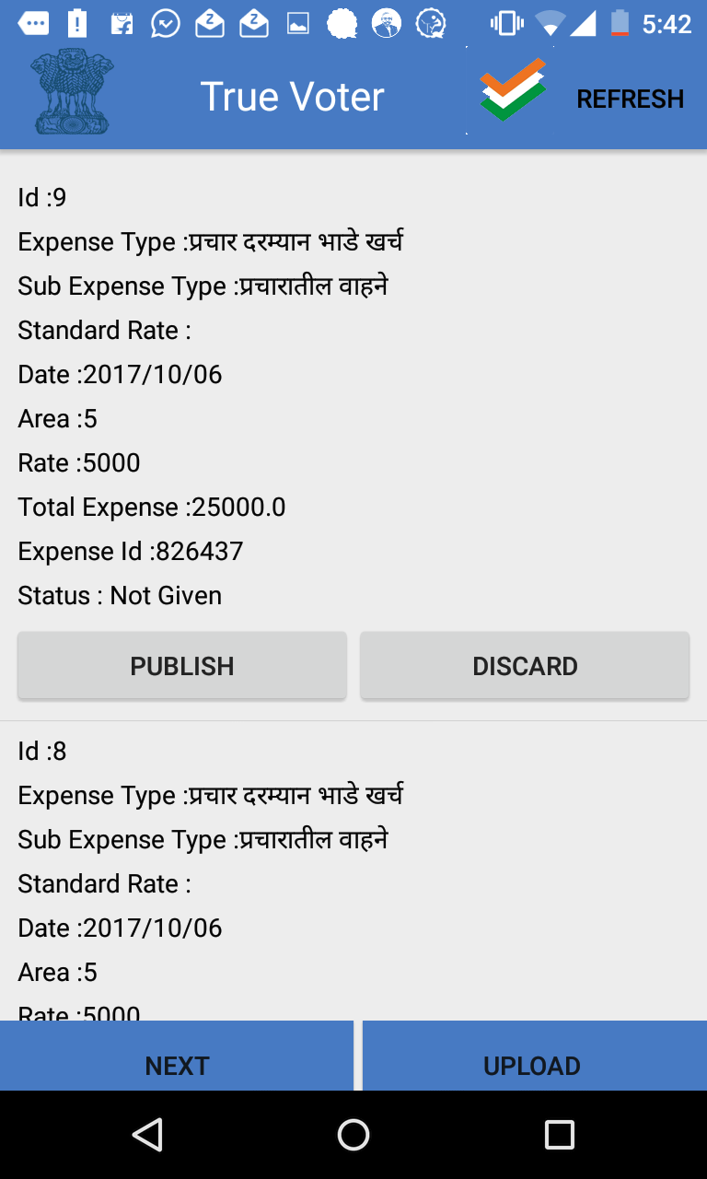
True Voter version 2.64
After uploading your Group Expense Click on Menu and then “Expense Report”
You will see the daily Expense List you can Publish\ Discard your daily Expenses of group
Click on Publish and then upload it.

Slide 16
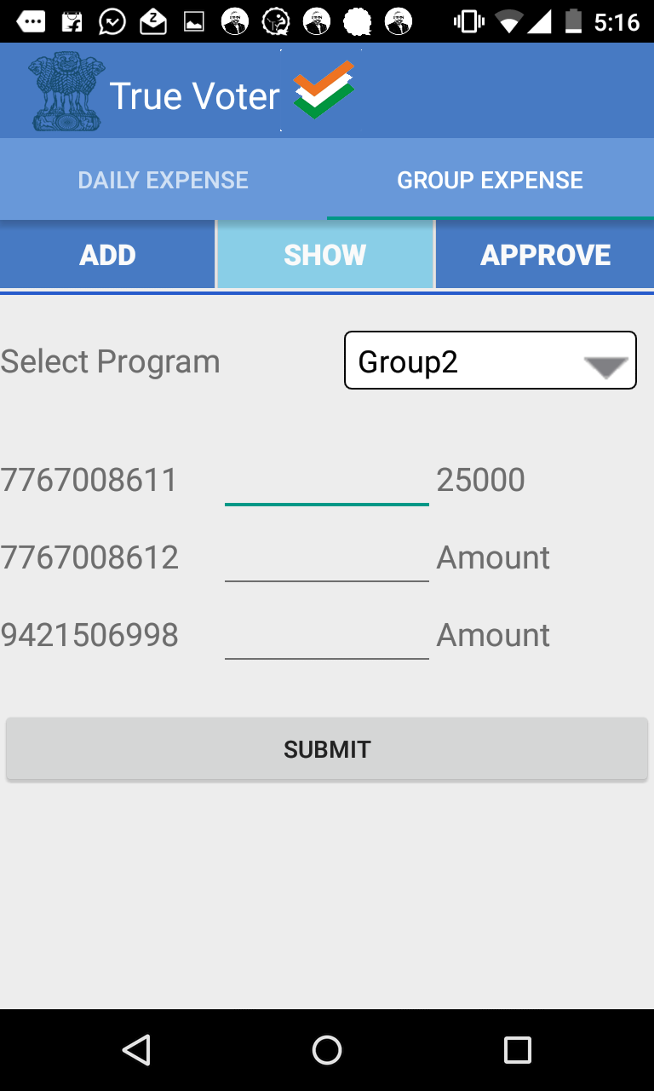
True Voter version 2.64
Click on ‘SHOW’ button.
Select your program / Group name.
It gives you list of total members with mobile numbers.
Your filled group expese total amount is shown.
Split this with your group members.

Slide 17
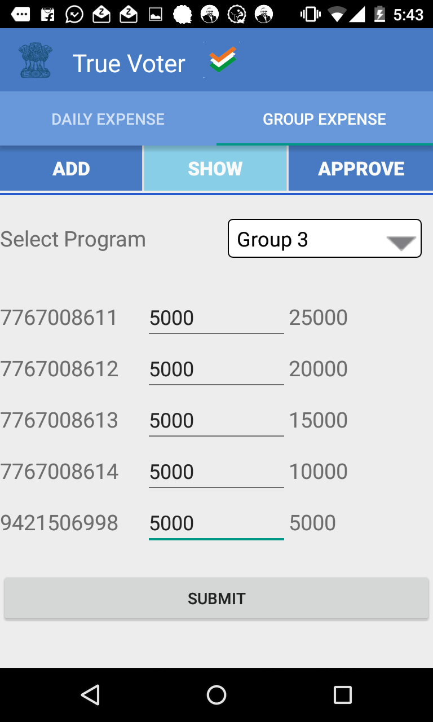
True Voter version 2.64
Enter the seperate amount for every group member.
Example is shown in screen.
Click on ‘Submit’ button.

Slide 18
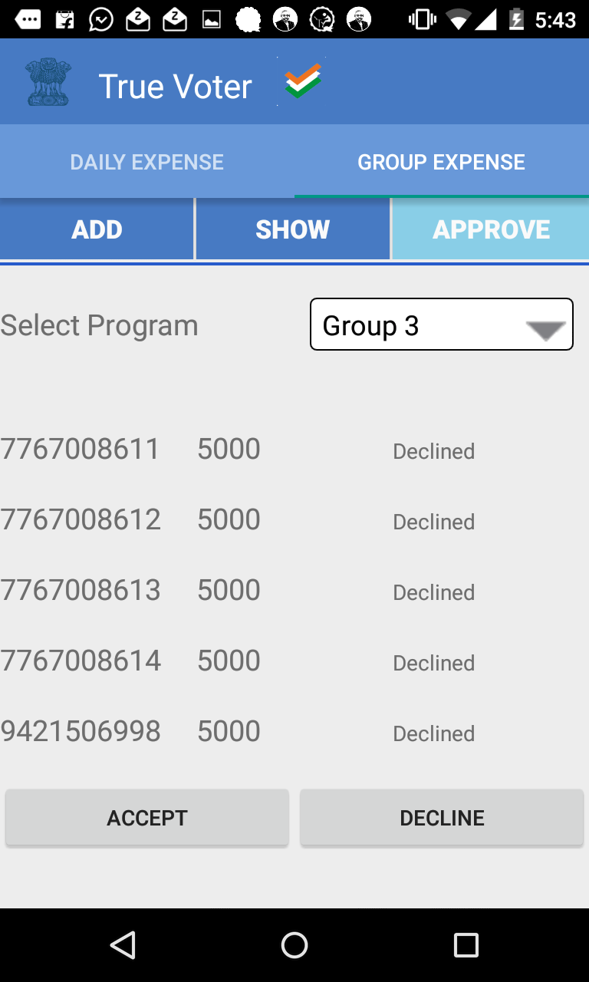
True Voter version 2.64
Click on ‘Approve’ button.
This screen will open.
By default Amount status is decline.
Check your amount and click on Accept button.

Slide 19
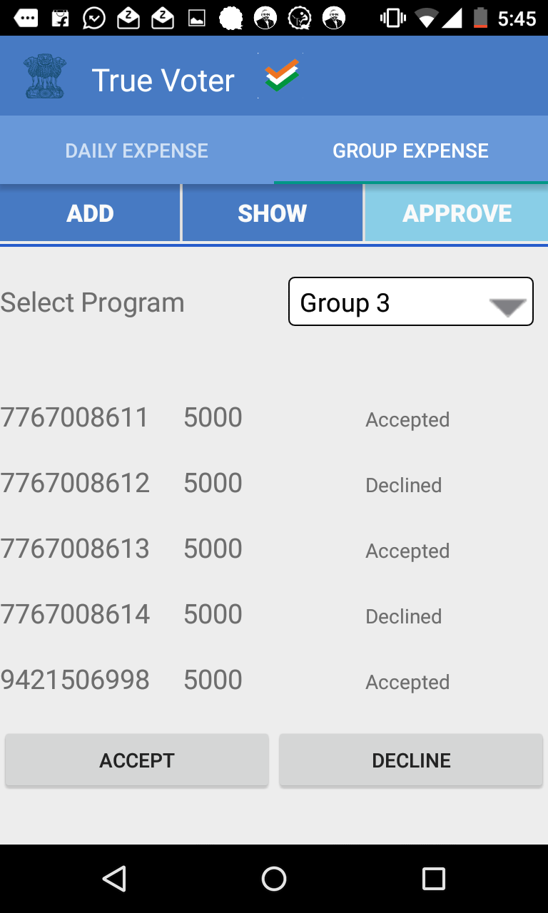
True Voter version 2.64
Click on ‘Approve’ button.
Now when other members are login from their mobile number then this list will also shown in their mobile
If the amount is correct then member will click on accept button.
If the amount is wrong then member will click on decline button.
When other members will Accept/Decline then this status will also display in your mobile as shown in screen.

